Slide 1
Studies on Influential node of complex networks
Under the Guidance of
Prof. Susanta Chakraborty
Members:
Arijit Saha (510517004)
Rohit Kumar (510517007)
Subhajyoti Saha (510517024)
Akash Singh (510517012)

Slide 2
Outline
Introduction
Motivation
Objective
Preliminaries
Our Approach
Example
Dataset
Result and Analysis
Future Scope

Slide 3
Introduction

Slide 4
Introduction
Complex Networks have become an integral part of our life, without our knowledge.
Facebook ego networks, Google Plus Circles, WhatsApp group chats are just a few examples of networks that are created on a global scale.
Gene Regulatory Networks are formed in biological processes that regulate genomes in human body and can be represented as complex networks.
Influential Nodes are taken as the nodes with minimum clustering coefficient, maximum degree centrality, betweenness centrality, closeness centrality and edge contribution factor.

Slide 5
Motivation

Slide 6
Motivation
We can predict the pattern of spreading of data given the source by finding the influential nodes in a complex network.
We can identify the key nodes that if changed can affect the networks data transfer.
We can identify the nodes that exhibit the most potential for spreading viruses, if the given graph pertains to a computer network.

Slide 7
Complex Network Analysis
Complex network analysis is the process of investigating Complex structures through the use of networks and graph theory.
It characterizes networked structures in terms of nodes and the ties, edges, or links (relationships or interactions) that connect them.
This Analysis is done by creating a mathematical model of the Complex Network Graph.

Slide 8
Applications of Complex Network Analysis
Finding Political Preferences of the general Public
Social Score of a person on a network such as Facebook, Orkut, Twitter
Finding Key Targets in terrorist Organisations
Finding Clusters among Social Networks and draw inferences regarding location and psychology
Gene Regulatory Network, to find the key genomes cause the propagation of genetic diseases and cure accordingly.

Slide 9
OBjective

Slide 10
Objective
Calculation of Centrality Measures such as Clustering Coefficient, Betweenness Centrality, Closeness Centrality, Degree Centrality, Edge Contribution Factor.
Identification of most influential node (central) from the given graph according to the above factors.

Slide 11
Preliminaries

Slide 12
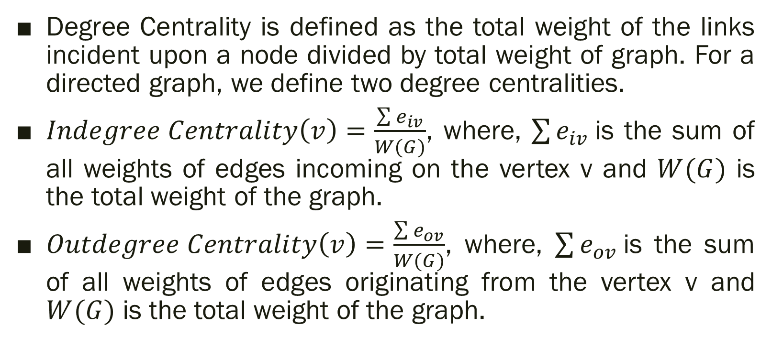
Degree Centrality
Degree Centrality is defined as the total weight of the links incident upon a node divided by total weight of graph. For a directed graph, we define two degree centralities.
$Indegree Centrality\left(v\right)=\frac{\sum{e_{iv}}}{W(G)}$, where, $\sum{e_{iv}}$is the sum of all weights of edges incoming on the vertex v and $W(G)$ is the total weight of the graph.
$Outdegree Centrality\left(v\right)=\frac{\sum{e_{ov}}}{W(G)}$, where, $\sum{e_{ov}}$is the sum of all weights of edges originating from the vertex v and $W(G)$ is the total weight of the graph.

Slide 13
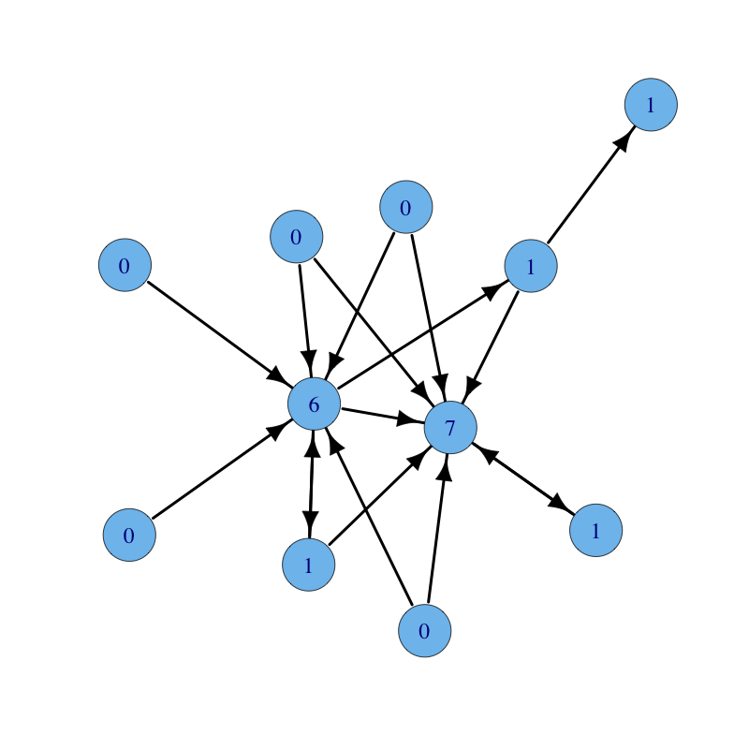
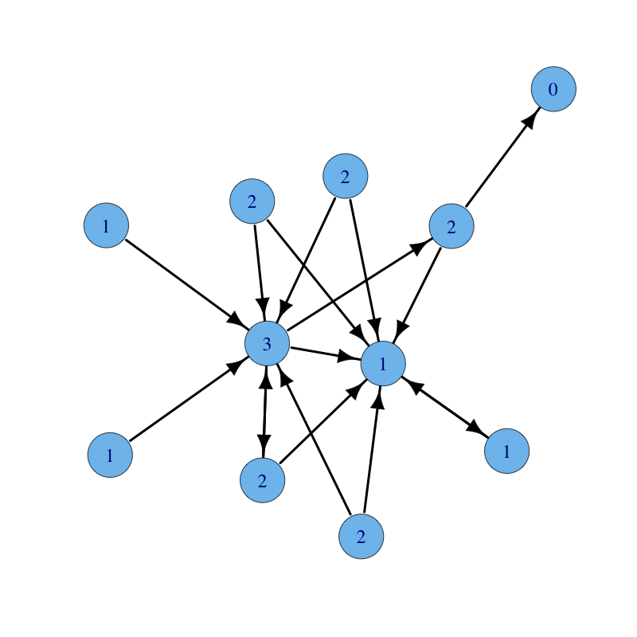
Degree Centrality
Graph with Indegree Count written on nodes
Graph with Outdegree Count written on nodes

Slide 14
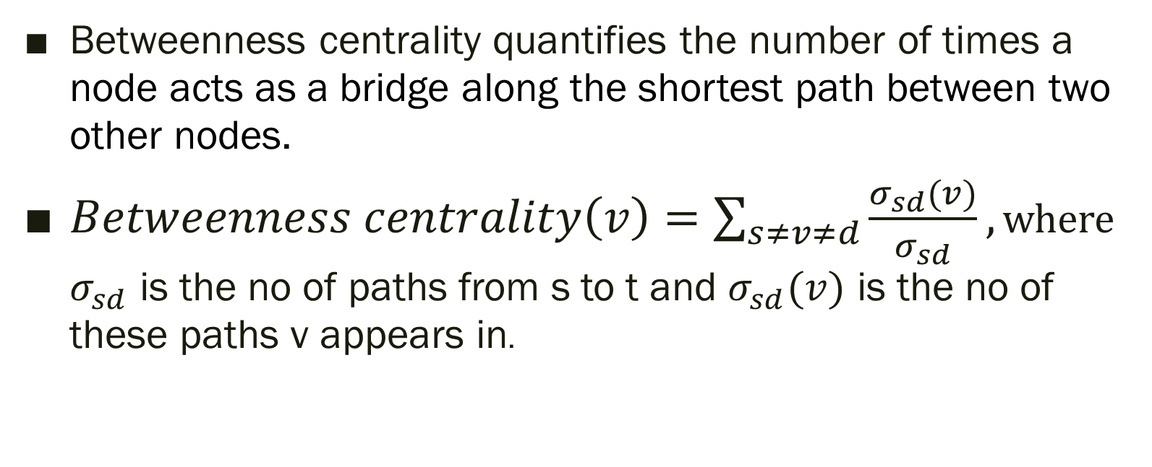
Betweenness Centrality
Betweenness centrality quantifies the number of times a node acts as a bridge along the shortest path between two other nodes.
$Betweenness centrality\left(v\right)=\sum_{s≠v≠d}{\frac{σ_{sd}(v)}{σ_{sd}}},$ where $σ_{sd}$ is the no of paths from s to t and $σ_{sd}(v)$ is the no of these paths v appears in.

Slide 15
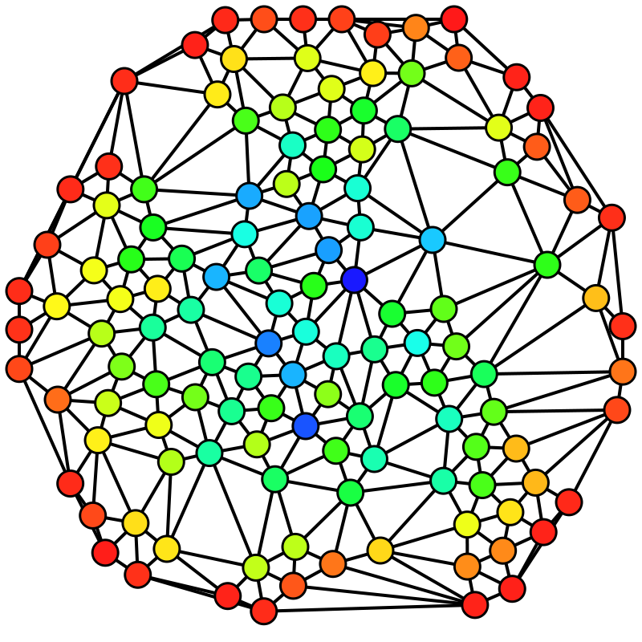
Betweenness Centrality
Undirected Graph Coloured On The Basis Of Betweenness Centrality
Blue to Red corresponds to High to Low Betweenness Centrality

Slide 16
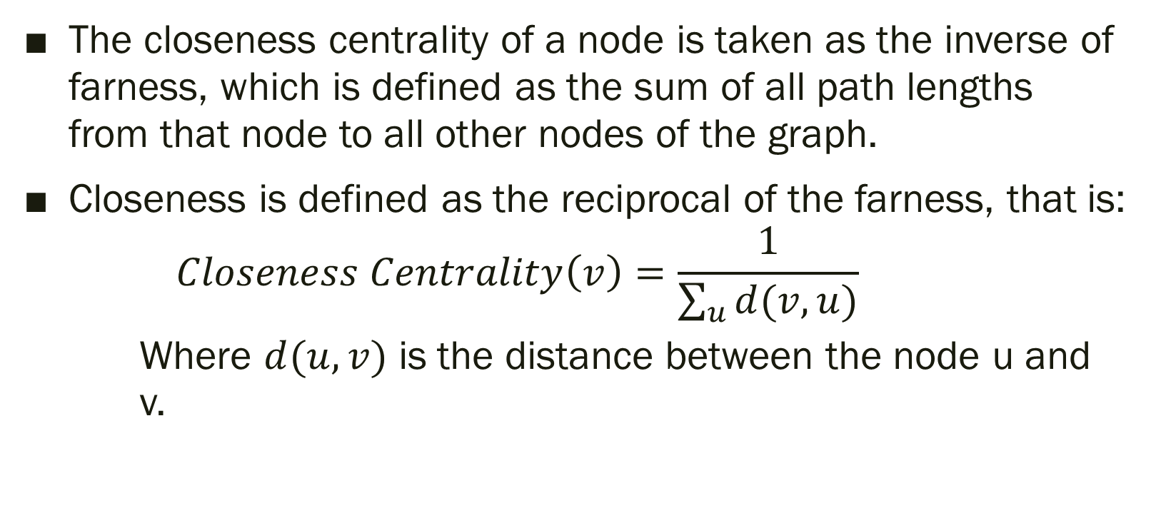
Closeness Centrality
The closeness centrality of a node is taken as the inverse of farness, which is defined as the sum of all path lengths from that node to all other nodes of the graph.
Closeness is defined as the reciprocal of the farness, that is:
$$Closeness Centrality\left(v\right)=\frac{1}{\sum_{u}{d(v,u)}}$$
Where $d(u,v)$ is the distance between the node u and v.

Slide 17
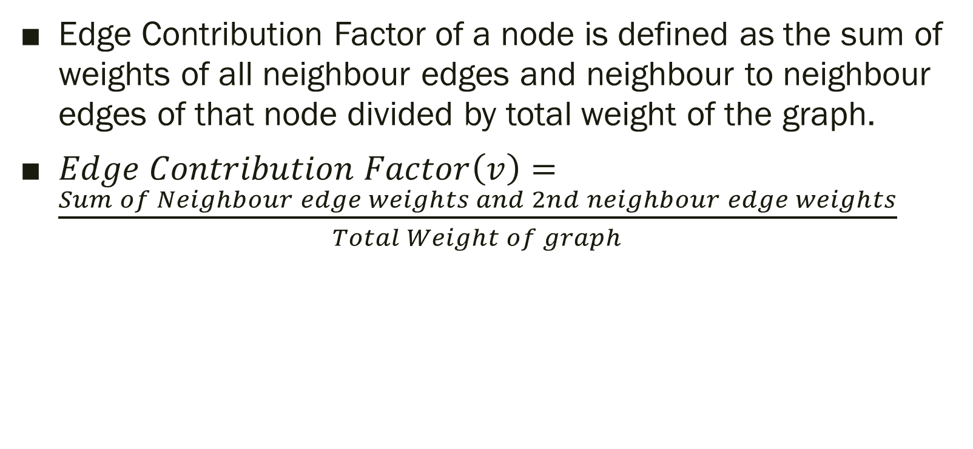
Edge Contribution Factor
Edge Contribution Factor of a node is defined as the sum of weights of all neighbour edges and neighbour to neighbour edges of that node divided by total weight of the graph.
$Edge Contribution Factor\left(v\right)=\frac{Sum of Neighbour edge weights and 2nd neighbour edge weights}{Total Weight of graph}$

Slide 18
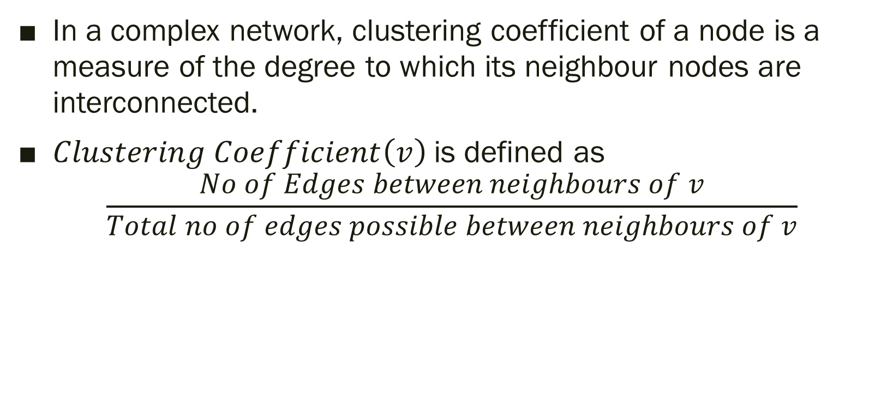
Clustering Coefficient
In a complex network, clustering coefficient of a node is a measure of the degree to which its neighbour nodes are interconnected.
$Clustering Coefficient\left(v\right)$is defined as
$$\frac{No of Edges between neighbours of v}{Total no of edges possible between neighbours of v}$$

Slide 19
Our Approach

Slide 20
Our Approach
We have calculated Closeness Centrality and Betweenness Centrality using their mathematical definition with the help of Dijkstra’s Algorithm to find out all shortest paths.
For Edge Contribution Factor and Degree Centralities, both Indegree and Outdegree, we have calculated using simple traversal though all nodes and summing their Indegree Count and Outdegree Count.
For Clustering Coefficient, we take a simple ratio of all neighbour edges with total possible directed edges between the neighbours.

Slide 21
AN Example

Slide 22
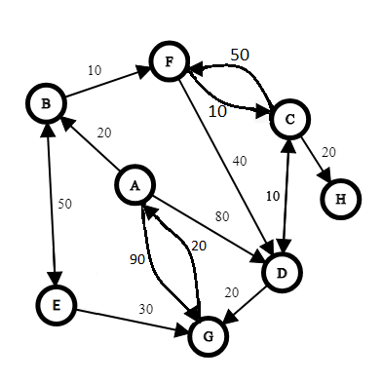
Example
We applied our algorithm to the following graph :

Slide 23
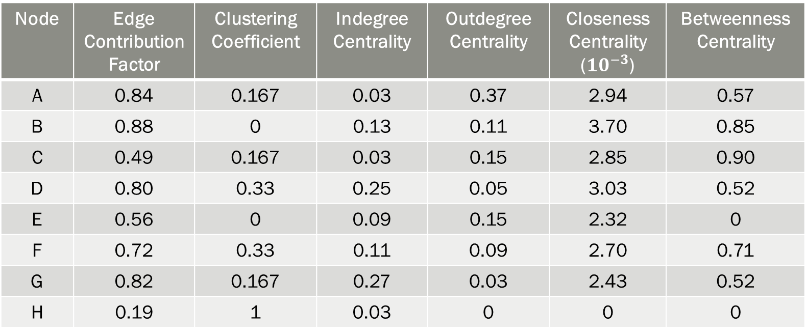
Example
Node | Edge Contribution Factor | Clustering Coefficient | Indegree Centrality | Outdegree Centrality | Closeness Centrality (${10}^{−3}$) | Betweenness Centrality
A | 0.84 | 0.167 | 0.03 | 0.37 | 2.94 | 0.57
B | 0.88 | 0 | 0.13 | 0.11 | 3.70 | 0.85
C | 0.49 | 0.167 | 0.03 | 0.15 | 2.85 | 0.90
D | 0.80 | 0.33 | 0.25 | 0.05 | 3.03 | 0.52
E | 0.56 | 0 | 0.09 | 0.15 | 2.32 | 0
F | 0.72 | 0.33 | 0.11 | 0.09 | 2.70 | 0.71
G | 0.82 | 0.167 | 0.27 | 0.03 | 2.43 | 0.52
H | 0.19 | 1 | 0.03 | 0 | 0 | 0

Slide 24
Example
After Voting on the factors as our algorithm in Our Approach Section Suggests, we get the most influential node to be node B with 3 votes.

Slide 25
Dataset

Slide 26
Dataset
We have taken a free dataset from Wiki-Vote which is a directed weighted network.
The network contains all the Wikipedia Voting data from the inception of Wikipedia till January 2008 that consist of 1235 elections.
Nodes in the network represent wikipedia users and a directed edge from node i to node j with weight w represents that user i voted for user j, w times.
The Graph Contains 7066 nodes (voters and candidates) and has in total 103663 votes.

Slide 27
RESULT

Slide 28
Result
Minimum (non zero) Clustering Coefficient: 0.140936
Maximum Closeness Centrality: 0
Maximum Betweenness Centrality: 0.000331
Maximum Outdegree Centrality: 0.003667
Maximum Indegree Centrality: 0.000042
Maximum Edge Contribution Factor: 0.000729
Key Node: Node no 3

Slide 29
Future Scope

Slide 30
Future Scope
In the future, our aim is to be able to assimilate the temporal data associated with each node such that we can find out at which point of time a node was influential (or central) in this network.
By using the above data, and concepts of Machine Learning, we also aim to be able to predict the shift in Centrality of the Network as time passes.

